Slide 1
IMU（Inertial Measurement Unit）

Slide 2
What is Attitude？
Orientation of a coordinate system (u,v,w) with respect to some reference system (x,y,z)

Slide 3
Why we need Attitude information
Obtaining an accurate vehicle attitude is essential for airplane navigation and control applications. The effectiveness of navigation and control is determined by the degree of precision of the navigation and control systems, including inertial measurement units(IMU).

Slide 4
How to get Attitude
The attitude of the aero-vehicle can be determined by integrating the angular rates (pitch, roll, and yaw rates) of the vehicle. Nevertheless, accuracy requirements usually cannot be satisfied by using the inexpensive MEMS sensors. Therefore, some forms of Kalman filtering or complementary fusion algorithms are normally employed to provide more accurate and reliable attitude angles in the MEMS attitude determination systems.

Slide 5
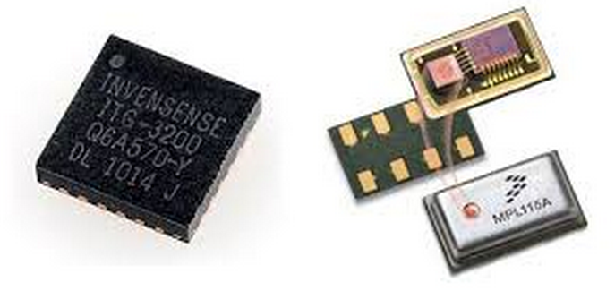
Attitude sensors
Accelerometers
Gyroscopes
gimbaled gyroscopes, laser gyroscopes, and fiber optic gyroscopes and accelerometers—provide high-precision information for navigational calculations .they are, however, expensive and bulky. With the maturation and advancement of semiconductor manufacturing technology, MEMS sensors are increasingly used in flight attitude calculations

Slide 6
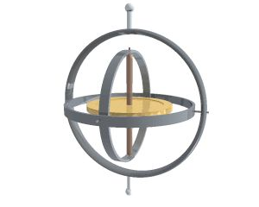
Gyroscopes
A gyroscope has the capability of measuring the rate of rotation around a particular axis. For instance if a gyroscope is used to gauge the rate of rotation around the roll axis of an aircraft, it will come up with a non zero roll value, so long as the aircraft continues to roll, but shows zero if the roll stops
陀螺仪演示视频：
http://www.iqiyi.com/w_19rs2xeeq1.html

Slide 7
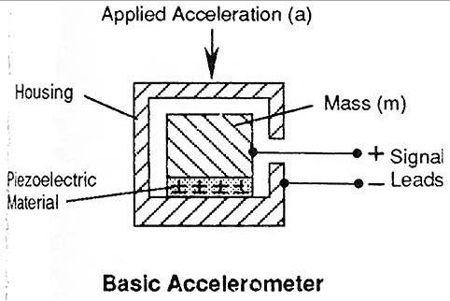
Accelerometer
A 3 axis accelerometer has the ability to gauge the orientation of a stationary platform relative to the earth’s surface. If the platform happens to be in free fall, the acceleration will be shown to be zero. If it is only accelerating in a particular direction the acceleration will be indistinguishable from the acceleration being provided by the earth’s gravitational pull. So an accelerometer alone cannot be used to have an aircraft maintain a particular orientation.

Slide 8
Difference Between Gyroscope and Accelerometer
Accelerometer measures linear motion and gravity.
Accelerometer detects and measures electrical current that derives from muscular action.
The magnitude of the signal in the case of accelerometer is biased by gravity. This is not the case with gyroscope.
Information pertains to bandwidth and frequency available to the extent of zero frequency in the case of gyroscope. That may not be the case with an accelerometer.
A onetime integration is sufficient to achieve angular displacement in the case of gyroscope, whereas a difficult two time integration is required in the case of accelerometer.
There is high signal to noise ratio in the case of gyroscope, while in accelerators, there is mostly a low signal to noise ratio.

Slide 9
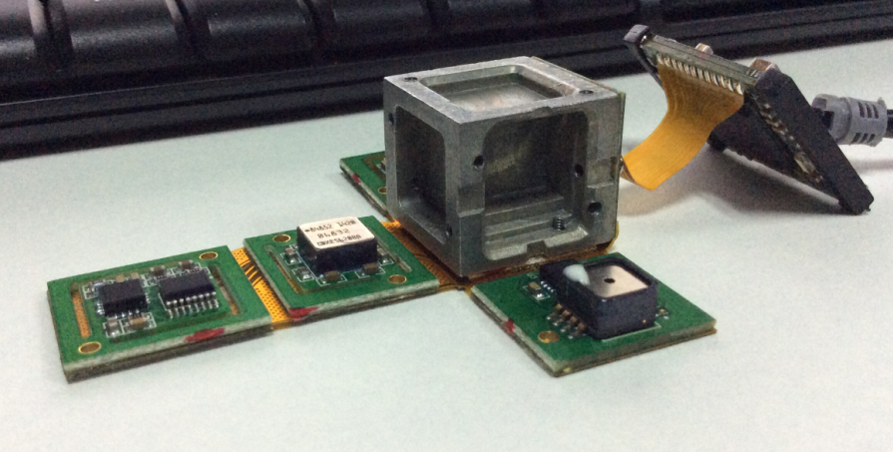
IMU of WKM Flight Controllers
Accelerometer：ADXL326
Gyroscopes： ADXRS620

Slide 10
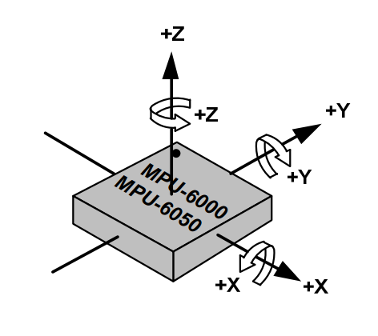
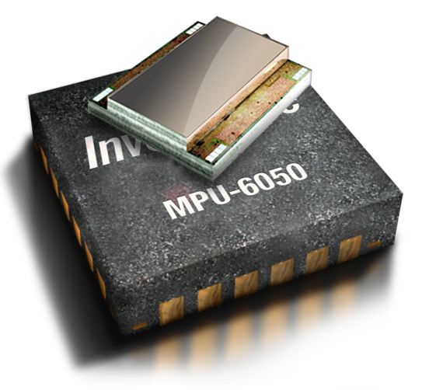
MPU-6050
combine a 3-axis gyroscope and a 3-axis accelerometer on the same silicon die.
Orientation of Axes of Sensitivity
and Polarity of rotation
Gyro Full Scale Range | Gyro Sensitivity | Accel Full Scale Range | Accel Sensitivity | Digital Output
±250 | 131 | ±2 | 16384 | I²C
±500 | 65.5 | ±4 | 8192
±1000 | 32.8 | ±8 | 4096
±2000 | 16.4 | ±16 | 2048

